Slide 1

APEX INSTITUTE OF TECHNOLOGY
DEPARTMENT OF COMPUTER SCIENCE & ENGINEERING
Statistics for Data Science(23CSH-233)
Faculty: Prof. (Dr.) Madan Lal Saini(E13485)
Lecture – 27
Locally weighted regression
DISCOVER . LEARN . EMPOWER

Slide 2
Statistics for Data Science : Course Objectives
COURSE OBJECTIVES
The Course aims to:
To equip students with the skills to summarize and interpret data using descriptive statistics and visualization techniques.
To develop a foundational understanding of probability and its applications in data science.
To enable students to perform hypothesis testing and construct confidence intervals for statistical inference.
To teach students how to build and assess linear and logistic regression models for predictive analysis.
To provide hands-on experience with statistical software for data manipulation, analysis, and visualization.

Slide 3
COURSE OUTCOMES
On completion of this course, the students shall be able to:-
CO1 | Summarize and describe the main features of a dataset using measures such as mean, median, mode, variance, and standard deviation, as well as graphical representations like histograms, box plots, and scatter plots.
CO2 | Understand of probability theory, including concepts such as random variables, probability distributions, and the law of large numbers, enabling them to model and reason about uncertainty in data.
CO3 | Apply/perform statistical inference, including hypothesis testing, confidence interval estimation, and p-value computation, to draw valid conclusions from sample data about larger populations.
CO4 | Apply linear and logistic regression techniques to identify relationships between variables, make predictions, and evaluate model performance.
CO5 | Utilize statistical software tools to perform data analysis, including data cleaning, transformation, visualization, and implementing various statistical methods.

Slide 4
Unit-2 Syllabus
Unit-2 | Probability Distribution
Probability Distribution | Concept of Random Variable, Bernoulli Distribution, Binomial Distribution, Poisson Distribution, Normal Distribution.
Correlation and Regression | Concept and types, Karl Pearson Method, Rank, Spearman Method, Least Square Method, Regression line by regression coefficient

Slide 5
SUGGESTIVE READINGS
TEXT BOOKS:
T1. Hastie, Trevor, et al., The elements of statistical learning. Vol. 2. No. 1. New York: Publisher: Springer, Edition: Second Edition (2009), ISBN: 978-0387848570
T2. Montgomery, Douglas C., and George C. Runger. Applied statistics and probability for engineers. John Wiley & Sons, 2010.
T3. Probability and Statistics The Science of Uncertainty Second Ed., Michael J. Evans and Jeffrey S. Rosenthal.
REFERENCE BOOKS:
R1. Practical Statistics for Data Scientists: 50 Essential Concepts, Authors: Peter Bruce, et al, Publisher: O'Reilly Media, Edition: Second Edition (2020), ISBN: 978-1492072942
R2. An Introduction to Statistical Learning: with Applications in R, Authors: Gareth James, et al, Publisher: Springer, Edition: Second Edition (2021), ISBN: 978-1071614174
R3. Think Stats: Exploratory Data Analysis in Python, Author: Allen B. Downey, Publisher: O'Reilly Media, Publication Year: 2014 (2nd Edition), ISBN: 978-1491907337

Slide 6
Contents
Locally weighted linear regression
Regression for non linear data
Basics of locally weighted regression
Minimization of cost function

Slide 7
Locally weighted regression:
The Phrase locally weighted regression is called
Local because the function is approximated based on data near the query point,
Weighted because the contribution of each training example is weighted by its distance from query point and
Regression because this is the term used widely in the statistical community for the problems of approximating real valued function.
7

Slide 8
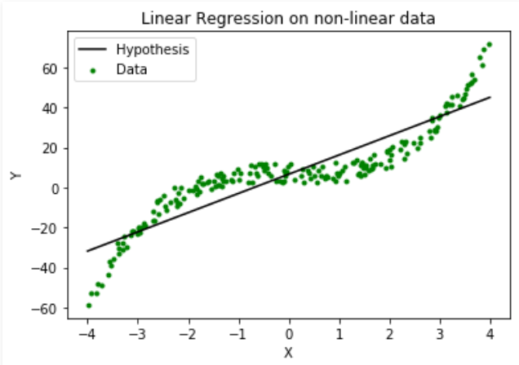
Introduction
From the figure it is clear that the linear regression cannot be used for making predictions when there exists a non-linear relationship between X and Y. In such cases, locally weighted linear regression is used.

Slide 9
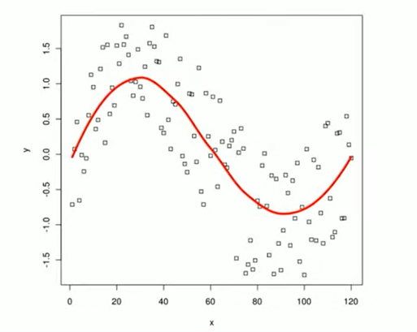
Introduction contd…
Locally weighted regression constructs an explicitly approximation to y over the local region corresponding to the query point.
If training data set is given then the value of at any given query point can be approximated using locally weighted regression. It is an approach to construct an approximation of the data set that fits the training example in the neighborhood surrounding .
9
Notes:
Background source: PCA (1992).

Slide 10
Locally weighted linear regression
Consider the case in which target function is approximated near using linear function as
Here, are the value of attributes of the instance , and are the regression parameters.
In the Locally weighted regression, parameters are chosen to minimize the weighted cost function i.e.,
here d denote the distance function.

Slide 11
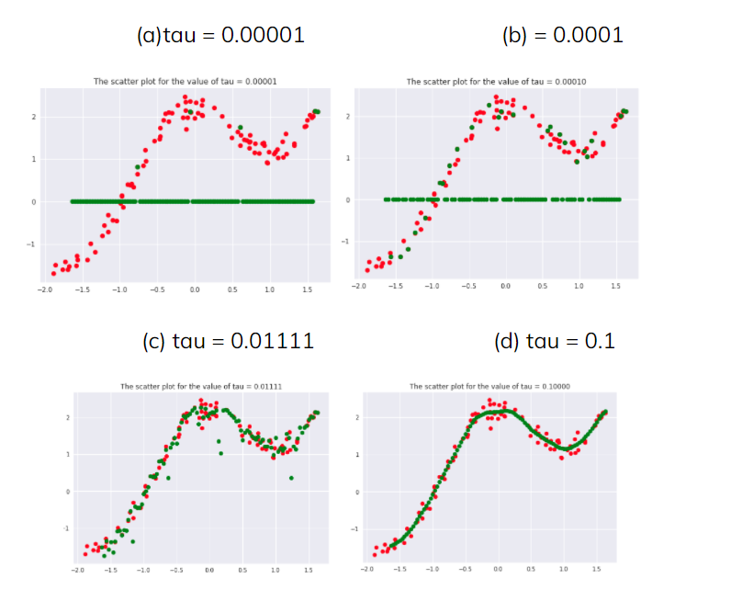
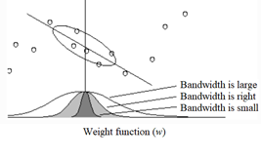
Weight function:
In general, the weight functions are assumed as
where, is bandwidth of weight

Slide 12
Minimization of cost function
There are three criteria to minimize the cost:
1) Minimize the squared error over just k-nearest neighbours (In linear regression)
2) Minimize squared error over entire set of training example, while weighting the error of each training example is decreasing function of its distance from the query point
3) It is the combination of 1 and 2.

Slide 13
Locally weighted regression
In all three cases, the cost function can be minimized for by using both the gradient descent algorithm and method of least square.
For the case 3, the redrive gradient descent rule can be given as
Note: is a kernel function is used to determine the weight of each training example using distance.
Notes:
Background source: PCA (1992).

Slide 14
Example:
Given the set of 50 samples (X and Y respectively) as
Then, use the locally weighted regression to approximate the given data.
554 | 1532 | 1248 | 797 | 629 | 547 | 424 | 384 | 360 | 319
3014 | 1416 | 1052 | 743 | 609 | 486 | 403 | 384 | 358 | 318
2171 | 1326 | 951 | 665 | 596 | 471 | 400 | 383 | 354 | 311
1891 | 1297 | 936 | 662 | 590 | 462 | 386 | 370 | 347 | 307
1593 | 1266 | 918 | 652 | 582 | 435 | 386 | 365 | 320 | 290

Slide 15
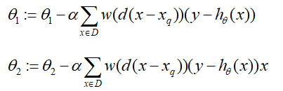
Solution:
Consider the hypothesis as the linear regression as
For locally weighted regression the cost function can be taken as
Form the gradient descent algorithm and can be approximated as
Applying this algorithm by taking different values of , it can be observed that bandwidth in weight function has significant effect and the correct value of should be taken to get accurate prediction.

Slide 16
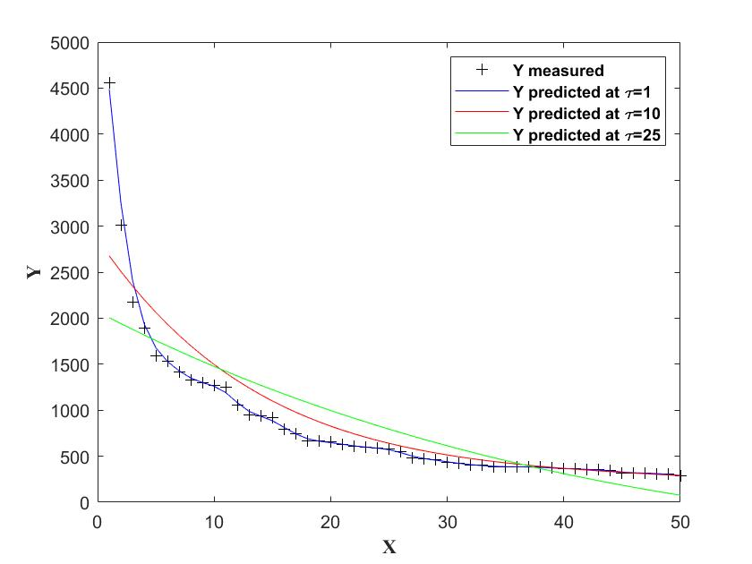
Graphical representation:

Slide 17
Exercise:
Given data:
X 2 5 8 12 15 20 27 30 45
Y 250 300 330 360 310 280 200 140 110
Apply the locally weighted regression and find the prediction of the given data
1. By using the gradient descent algorithm
2. By using the least square method

Slide 18
References
Online Video Link-
https://www.youtube.com/watch?v=het9HFqo1TQ
Textbooks / Reference Books
Text Books
T1: Advanced Engineering Mathematics by R.K. Jain and S. R. K. Iyengar, Narosa Publications.
T2: Probability and Statistics for Engineers and Scientists by Sheldon M. Ross, Academic Press.
Reference Books
R1: Fundamental of mathematical Statistics by SC Gupta and VK Kapoor, S. Chand Publication.
R2: Probability by Lipschitz, Schaum outline series, Mc.Graw hill Publication.

Slide 19
References
Books:
Hastie, Trevor, et al., The elements of statistical learning. Vol. 2. No. 1. New York: Publisher: Springer, Edition: Second Edition (2009), ISBN: 978-0387848570
Practical Statistics for Data Scientists: 50 Essential Concepts, Authors: Peter Bruce, et al, Publisher: O'Reilly Media, Edition: Second Edition (2020), ISBN: 978-1492072942
Research Papers:
Carmichael, Iain, and J. S. Marron. "Data science vs. statistics: two cultures?." Japanese Journal of Statistics and Data Science 1.1 (2018): 117-138.
Hardin, Johanna, et al. "Data science in statistics curricula: Preparing students to “think with data”." The American Statistician 69.4 (2015): 343-353.
Websites:
https://365datascience.com/resources-center/course-notes/statistics/
https://www.geeksforgeeks.org/7-basic-statistics-concepts-for-data-science/
Videos:
https://www.youtube.com/playlist?list=PLZ2ps__7DhBYrMs3zybOqr1DzMFCX49xG

Slide 20
THANK YOU
For queries
Email: madan.e13485@cumail.in

